Slide 1
Identifying synthetic anti-metastasis gene pairs from TCGA
2023. 07. 22
Seongsu Lim

Slide 2
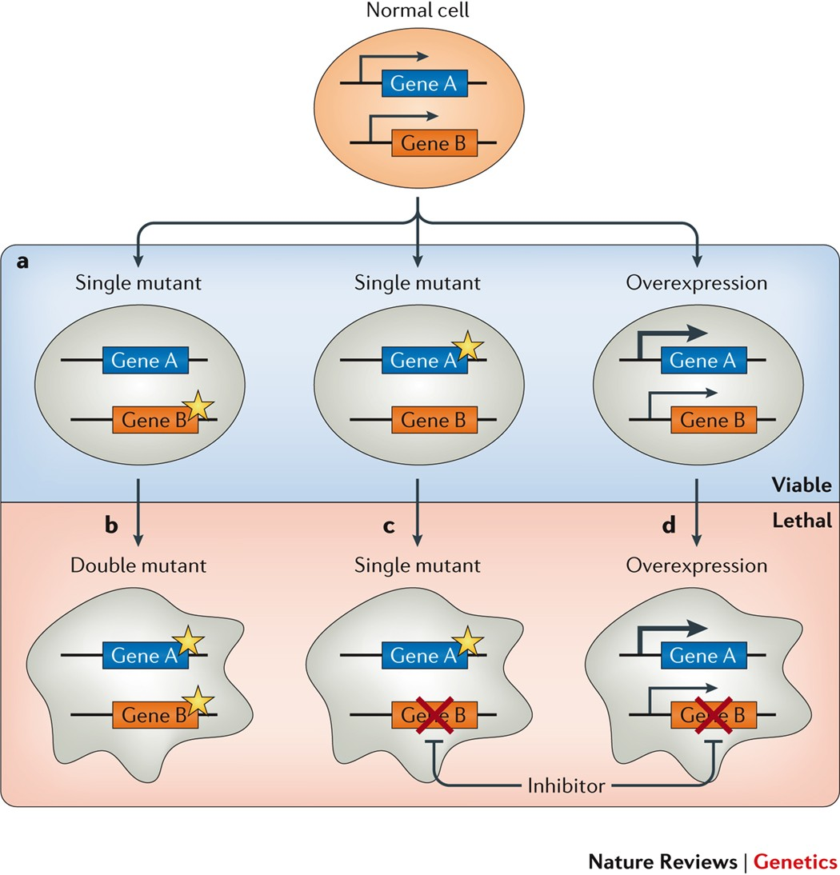
Introduction |
Need to find biomarkers related to prevent cancer metastasis or invasion
➔ Efforts to develop anti-metastatic and anti-invasion therapeutic drugs to prevent cancer metastasis have almost failed
➔ Based on biomarkers related to prevent cancer metastasis or invasion would be helpful to find anti-metastatic or invasion drugs
Discovery Synthetic Anti-Metastasis gene pair
➔ Gene pair biomarkers would have more biological phenotypic robustness than single biomarkers
➔ Greatly increase the number of effective targets by analyzing at the level of gene pairs beyond individual genes.
- Nigel J. O'Neil et al, Nature reviews genetics, 2017

Slide 3



Data | TCGA MC3 Project maf file & TCGA clinical data
115 attributes for mutation information
➔ Hugo_symbol, Choromosome, Start position, Variant_classification, SIFT, Polyphen and GMAF etc
21,332 genes
16 variant types
➔ 3’ Flank, 3’ UTR, 5’ Flank, 5’ UTR, Frame_shift_Del, Frame_Shift_Ins, In_Frame_Del, In_Frame,_Ins, Intron, Missense_Mutation, Nonsense_Mutation, Nonstop_Mutationm RNA, Silent, Splice_Site, Translation_Start_Site
Mutation data
10,224 patients with 3,600,961 mutations
33 attributes for clinical information
➔ age_at_initial_pathologic_diagnosis, ajcc_pathologic_tumor_stage, OS.time and bcr_patient_barcode etc.
Clinical data
11,160 patients with 33 cancer types

Slide 4
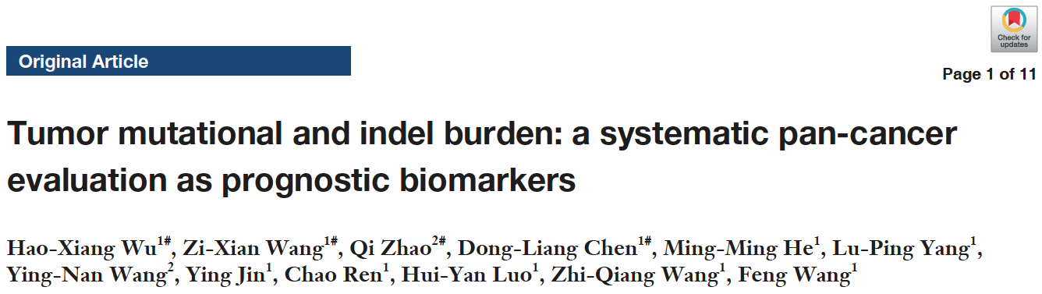

Data | TCGA Clinical features used in Cox regression
13 cancer types excluded
➔ CESC, DLBC, GBM, LAML, LGG, OV, PCPG, PRAD, SARC, TGCT, THYM, UCEC, UCS
➔ Exclude patients missing clinical features used in cox regression
➔ The number of death events was too small for OS analysis (TGCT)
Mutation data
10,224 patients with 3,600,961 mutations
Clinical data
11,160 patients with 33 cancer types

Slide 5
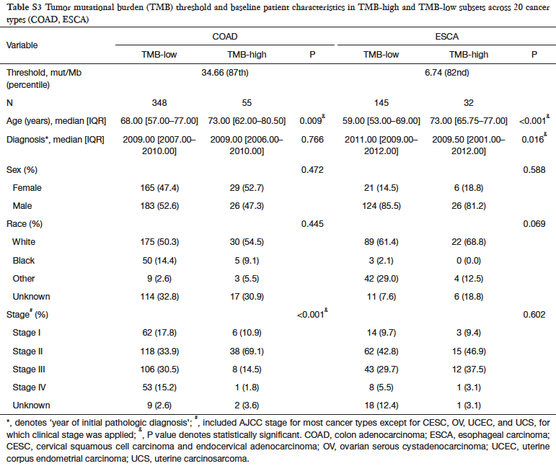
Data | TCGA Clinical features used in Cox regression
Mutation data
10,224 patients with 3,600,961 mutations
Clinical data
11,160 patients with 33 cancer types

Slide 6
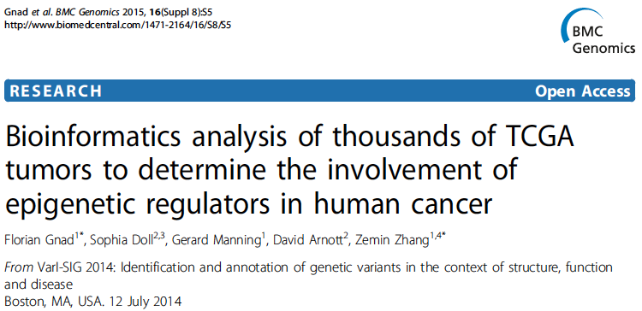
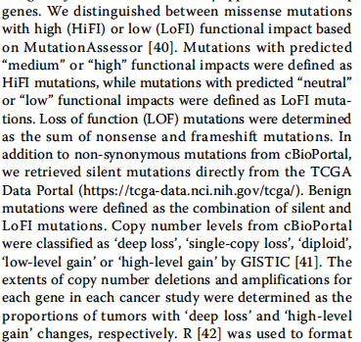
Data | TCGA Mutation types used GVB calculation
Mutation types used to calculate GVB
➔ Missense mutation : A point mutation in a codon that codes for a different amino acid
➔ Nonsense mutation : A point mutation in a DNA sequence that results a premature stop codon
➔ Frame_Shift_Ins : Bases insertion which causes a disruption of the translational reading frame
➔ Frame_Shift_Del : Bases deletion which causes a disruption of the translational reading frame
➔ In_Frame_Ins : An inframe non synonymous variant that inserts bases into in the coding sequence
➔ In_Frame_Del : An inframe non synonymous variant that deletes bases from the coding sequence
Mutation data
10,224 patients with 3,600,961 mutations
Clinical data
11,160 patients with 33 cancer types
- https://www.ebi.ac.uk/ols/ontologies/so/terms?obo_id=SO:0001821

Slide 7
Data | TCGA Mutation types used GVB calculation
Non-synonymous mutations
➔ Missense mutation
➔ Nonsense mutation
➔ In-frame mutation
Loss-of-function mutations
➔ Nonsense mutation
➔ Frameshift mutation
Mutation data
10,224 patients with 3,600,961 mutations
Clinical data
11,160 patients with 33 cancer types
- https://www.ebi.ac.uk/ols/ontologies/so/terms?obo_id=SO:0001821

Slide 8

Process | Identifying Synthetic Anti-Metastasis gene pairs from TCGA public data
Have all clinical features for cox regression
Mutation data
10,224 patients with 3,600,961 mutations
Passed by filter
Survival analysis
GVB calculation
5,518 patients with 20 cancer types
SAM gene pairs
For each cancer type
988,633
LOF and missense mutations
Clinical data
11,160 patients with 33 cancer types

Slide 9
Data | TCGA MC3 Project maf file & TCGA clinical data
Table 1. Data statistics for 33 cancer types
Table 2. Data statistics of input data (before)
Tumor type | Clinical & Mutation data
 | Patients | Genes | Non-synonymous mutations
TCGA-ACC | 81 | 4,224 | 5,863
TCGA-BLCA | 398 | 16,581 | 87,790
TCGA-BRCA | 771 | 14,481 | 48,152
TCGA-CHOL | 36 | 1,469 | 1,659
TCGA-COAD | 255 | 16,795 | 88,722
TCGA-ESCA | 162 | 9,672 | 19,957
TCGA-HNSC | 430 | 14,684 | 55,263
TCGA-KICH | 64 | 1,706 | 1,911
TCGA-KIRC | 360 | 9,091 | 16,479
TCGA-KIRP | 241 | 7,182 | 11,288
TCGA-LIHC | 337 | 12,176 | 30,303
TCGA-LUAD | 444 | 16,357 | 109,585
TCGA-LUSC | 369 | 15,915 | 90,527
TCGA-MESO | 80 | 1,891 | 2,135
TCGA-PAAD | 171 | 9,760 | 19,325
TCGA-READ | 72 | 10,026 | 21,398
TCGA-SKCM | 410 | 17,417 | 214,626
TCGA-STAD | 359 | 16,618 | 95,052
TCGA-THCA | 424 | 3,248 | 4,372
TCGA-UVM | 54 | 809 | 947
Total | 5,518 | 19,186 | 925,354
Have all clinical features for cox regression
Mutation data
10,224 patients with 3,600,961 mutations
5,518 patients with 20 cancer types
Clinical data
11,160 patients with 33 cancer types

Slide 10
Data | TCGA MC3 Project maf file & TCGA clinical data
Table 1. Data statistics for 33 cancer types
Table 2. Data statistics of input data (after)
Tumor type | Clinical & Mutation data
 | Patients | Genes | LOF & missense mutations
TCGA-ACC | 81 | 4,224 | 6,286
TCGA-BLCA | 398 | 16,581 | 90,028
TCGA-BRCA | 771 | 14,481 | 57,695
TCGA-CHOL | 36 | 1,469 | 1,781
TCGA-COAD | 255 | 16,795 | 101,814
TCGA-ESCA | 162 | 9,672 | 21,690
TCGA-HNSC | 430 | 14,684 | 57,950
TCGA-KICH | 64 | 1,706 | 1,995
TCGA-KIRC | 360 | 9,091 | 18,857
TCGA-KIRP | 241 | 7,182 | 13,157
TCGA-LIHC | 337 | 12,176 | 32,165
TCGA-LUAD | 444 | 16,357 | 114,063
TCGA-LUSC | 369 | 15,915 | 93,962
TCGA-MESO | 80 | 1,891 | 2,316
TCGA-PAAD | 171 | 9,760 | 19,756
TCGA-READ | 72 | 10,026 | 22,032
TCGA-SKCM | 410 | 17,417 | 216,417
TCGA-STAD | 359 | 16,618 | 110,083
TCGA-THCA | 424 | 3,248 | 4,599
TCGA-UVM | 54 | 809 | 987
Total | 5,518 | 19,208 | 988,633
Have all clinical features for cox regression
Mutation data
10,224 patients with 3,600,961 mutations
5,518 patients with 20 cancer types
Clinical data
11,160 patients with 33 cancer types

Slide 11
Data | TCGA MC3 Project maf file & TCGA clinical data
Table 2. Data statistics of input data (before)
Table 2. Data statistics of input data (after)
Tumor type | Clinical & Mutation data
 | Patients | Genes | Non-synonymous mutations
TCGA-ACC | 81 | 4,224 | 5,863
TCGA-BLCA | 398 | 16,581 | 87,790
TCGA-BRCA | 771 | 14,481 | 48,152
TCGA-CHOL | 36 | 1,469 | 1,659
TCGA-COAD | 255 | 16,795 | 88,722
TCGA-ESCA | 162 | 9,672 | 19,957
TCGA-HNSC | 430 | 14,684 | 55,263
TCGA-KICH | 64 | 1,706 | 1,911
TCGA-KIRC | 360 | 9,091 | 16,479
TCGA-KIRP | 241 | 7,182 | 11,288
TCGA-LIHC | 337 | 12,176 | 30,303
TCGA-LUAD | 444 | 16,357 | 109,585
TCGA-LUSC | 369 | 15,915 | 90,527
TCGA-MESO | 80 | 1,891 | 2,135
TCGA-PAAD | 171 | 9,760 | 19,325
TCGA-READ | 72 | 10,026 | 21,398
TCGA-SKCM | 410 | 17,417 | 214,626
TCGA-STAD | 359 | 16,618 | 95,052
TCGA-THCA | 424 | 3,248 | 4,372
TCGA-UVM | 54 | 809 | 947
Total | 5,518 | 19,186 | 925,354
Tumor type | Clinical & Mutation data
 | Patients | Genes | LOF & missense mutations
TCGA-ACC | 81 | 4,224 | 6,286
TCGA-BLCA | 398 | 16,581 | 90,028
TCGA-BRCA | 771 | 14,481 | 57,695
TCGA-CHOL | 36 | 1,469 | 1,781
TCGA-COAD | 255 | 16,795 | 101,814
TCGA-ESCA | 162 | 9,672 | 21,690
TCGA-HNSC | 430 | 14,684 | 57,950
TCGA-KICH | 64 | 1,706 | 1,995
TCGA-KIRC | 360 | 9,091 | 18,857
TCGA-KIRP | 241 | 7,182 | 13,157
TCGA-LIHC | 337 | 12,176 | 32,165
TCGA-LUAD | 444 | 16,357 | 114,063
TCGA-LUSC | 369 | 15,915 | 93,962
TCGA-MESO | 80 | 1,891 | 2,316
TCGA-PAAD | 171 | 9,760 | 19,756
TCGA-READ | 72 | 10,026 | 22,032
TCGA-SKCM | 410 | 17,417 | 216,417
TCGA-STAD | 359 | 16,618 | 110,083
TCGA-THCA | 424 | 3,248 | 4,599
TCGA-UVM | 54 | 809 | 987
Total | 5,518 | 19,186 | 988,633

Slide 12
Data | TCGA MC3 Project maf file & TCGA clinical data
Table 3. Clinical information of input data
Have all clinical features for cox regression
Mutation data
10,224 patients with 3,600,961 mutations
5,518 patients with 20 cancer types
Clinical data
11,160 patients with 33 cancer types

Slide 13
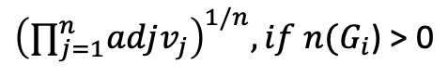
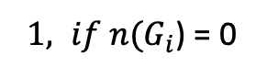
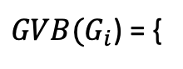
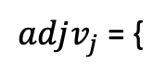
Method | Calculate Gene-wise variant burden(GVB) score : Previous analysis
GVB calculation
$$G_{i}=\left\{v \right| v with a SIFT score less than 0.7\}$$
Patients
$$SIFT score, if v_{j}∈G_{i} and heterozygote$$
$adjv_{j}$ = {
Genes
$${(SIFT score)}^{2}, if v_{j}∈G_{i} and homozygote$$
Genes with variants For each cancer type patients
$1, if n(G_{i}$) = 0
$GVB(G_{i}$) = {
$${\left(∏_{j=1}^{n}adjv_{j}\right)}^{1/n}, if n(G_{i}\text{) > 0}$$

Slide 14
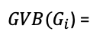
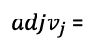
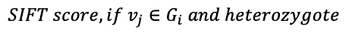
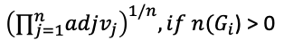
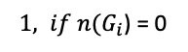
Method | Calculate Gene-wise variant burden(GVB) score : Current
Genes with variants For each cancer type patients
Calculate GVB
If genes have LOF mutations
No
$$G_{i}=\left\{v \right| v with a SIFT score less than 0.7\}$$
$$SIFT score, if v_{j}∈G_{i} and heterozygote$$
Yes
Calculate GVB
$adjv_{j}$ =
$${(SIFT score)}^{2}, if v_{j}∈G_{i} and homozygote$$
$1, if n(G_{i}$) = 0
GVB = 0
$GVB(G_{i}$) =
$${\left(∏_{j=1}^{n}adjv_{j}\right)}^{1/n}, if n(G_{i}\text{) > 0}$$
Patients
Genes

Slide 15
Method | GVB score density plot – Previous GVB calculation
All GVB value
Excluding GVB value 1

Slide 16
Method | GVB score density plot – Current GVB calculation
All GVB value
Excluding GVB value 1

Slide 17
Result | The result of previous GVB calculation for 20 cancer types
19,186 genes
Cancer type | The number of genes which have LOF and missense mutation | The number of genes which have GVB less than 0.3 at least one patient
ACC | 4,224 | 3,311
BLCA | 16,581 | 15,364
BRCA | 14,481 | 12,934
CHOL | 1,469 | 1,117
COAD | 16,795 | 15,638
ESCA | 9,672 | 8,121
HNSC | 14,684 | 13,198
KICH | 1,706 | 1,246
KIRC | 9,091 | 7,570
KIRP | 7,182 | 5,808
LIHC | 12,176 | 10,476
LUAD | 16,357 | 15,234
LUSC | 15,915 | 14,728
MESO | 1,891 | 1,415
PAAD | 9,760 | 8,170
READ | 10,026 | 8,352
SKCM | 17,417 | 16,521
STAD | 16,618 | 15,523
THCA | 3,248 | 2,510
UVM | 809 | 593

Slide 18
Result | The result of current GVB calculation for 20 cancer types
19,208 genes
Cancer type | The number of genes which have LOF and missense mutation | The number of genes which have GVB less than 0.3 at least one patient
ACC | 4,484 | 3,881
BLCA | 16,642 | 16,034
BRCA | 15,323 | 14,647
CHOL | 1,562 | 1,304
COAD | 17,138 | 16,647
ESCA | 10,154 | 9,134
HNSC | 14,901 | 14,022
KICH | 1,776 | 1,418
KIRC | 9,731 | 8,794
KIRP | 7,892 | 7,020
LIHC | 12,508 | 11,390
LUAD | 16,456 | 15,902
LUSC | 16,031 | 15,366
MESO | 2,019 | 1,659
PAAD | 9,858 | 8,752
READ | 10,195 | 9,166
SKCM | 17,451 | 16,998
STAD | 16,996 | 16,527
THCA | 3,374 | 2,823
UVM | 839 | 670

Slide 19
Method | Identifying SAM gene pairs using GVB calculation
Grouping
Both genes’ scores < 0.3
1
One gene scores < 0.3
Survival rate
One gene scores < 0.3
SAM gene pairs
For each cancer type
0
Time (days)
Neither genes’ scores ≥ 0.3

Slide 20
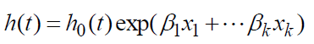
Method | Identifying SAM gene pairs using GVB calculation – Survival analysis
Kaplan-meier and Log-rank test
➔ Consider only time and event
➔ Non-Parametric analysis : Do not reflect data characteristic
Cox proportional hazard model
➔ Semi-parametric analysis
➔ Reflect data characteristic
➔ Do not reflect overall survival distribution
➔ The effect of multiple variables can be determined at the same time
➔ Can calculate Hazard ratio
➔ Penalizer : Attach a penalty to the size of the coefficients during regression so it can improve stability of the estimates
➔ h(t) : hazard function, the probability of dying immediately afterwards, assuming you survive until time t.
➔ h0(t) : baseline hazard function
➔ Penalizer = 0.5

Slide 21
Method | Compare between candidate genes and non-candidate genes - SKCM
Candidate genes
➔ From 17,417 genes, 16,521 genes have GVB < 0.3 at least one patients
➔ Cox regression < 0.05 : 0 genes
Non-candidate genes
➔ From 17,417 genes, 896 genes have GVB < 0.3 in no patients
Hazard rate
➔ The frequency at which the event of interest occurs per unit of time, given that it hasn't yet happened up until that time
Hazard ratio
➔ A measure of how often a particular event(death) happens in one group compared to how often it happens in another group, over time
➔ Hazard ratio formula : test hazard rate / control hazard rate
➔ Hazard ratio > 1 : Hazard rate of test group increase
➔ Hazard ratio = 1 : Same hazard rate between test group and control group
➔ Hazard ratio < 1 : Hazard rate of test group decrease
https://www.cancer.gov/publications/dictionaries/cancer-terms/def/hazard-ratio

Slide 22
Method | Ongoing analysis
Cox proportional hazard model
➔ BLCA, BRCA, ESCA, KIRC, KIRP, LIHC, LUAD, PAAD, SKCM(only previous)
Table 4. Candidate SAM pairs for 9 cancer types by previous GVB calculation
Table 5. Candidate SAM pairs for 9 cancer types by current GVB calculation
Cancer type | Pairs at least one patients | Candidate SAM pairs | SAM genes
BLCA | 8,873,807 | 0 | 0
BRCA | 5,024,712 | 0 | 0
ESCA | 1,247,034 | 0 | 0
KIRC | 270,924 | 0 | 0
KIRP | 155,873 | 0 | 0
LIHC | 1,422,352 | 0 | 0
LUAD | 10,518,761 | 3 | 5
PAAD | 22,605,312 | 0 | 0
SKCM | 41,490,932 | 123 | 146
Cancer type | Pairs at least one patients | Candidate SAM pairs | SAM genes
BLCA | 11,106,789 | 2 | 3
BRCA | 6,227,239 | 0 | 0
ESCA | 1,485,509 | 0 | 0
KIRC | 332,144 | 0 | 0
KIRP | 190,156 | 0 | 0
LIHC | 1,667,707 | 0 | 0
LUAD | 12,524,621 | 5 | 6
PAAD | 25,500,438 | 0 | 0

Slide 23
Result | Ongoing analysis
Candidate SAM pairs from TCGA LUAD
Table 6. Candidate SAM pairs by previous GVB method
Table 7. Candidate SAM pairs by current GVB method
Gene1 | Gene2 | HR | P-value
KCNT1 | SYNJ1 | 0.260932 | 0.049937
OTOF | TP53 | 0.513332 | 0.043093
SYNJ1 | WNK1 | 0.260603 | 0.048328
Gene1 | Gene2 | HR | P-value
CHTF18 | SYNJ1 | 0.255046 | 0.049194
KCNT1 | SYNJ1 | 0.253777 | 0.0434
MGAT5B | SYNJ1 | 0.315579 | 0.04803
SYNJ1 | SYNPO2 | 0.260319 | 0.046288
SYNJ1 | WNK1 | 0.256513 | 0.044902

Slide 24
Result | Ongoing analysis
Candidate SAM pairs from TCGA BLCA
Table 8. Candidate SAM pairs by current GVB method
Gene1 | Gene2 | HR | P-value
JMJD1C | TP53 | 0.51332 | 0.040334
SLC4A5 | TP53 | 0.394936 | 0.044865

Slide 25
Future plan |
Exclude synthetic lethality interactions
Gene essentiality analysis
Phylogenetic analysis

Slide 26
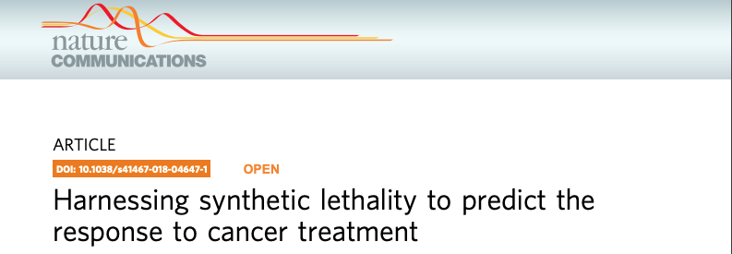
Future plan | Exclude synthetic lethality interactions
Hypothesis
➔ SAM pairs are not discovered in SL pairs identified by experiments
Experimentally identified SL interactions
➔ All interactions : 154,707
➔ Synthetic lethal interaction : 6,033
➔ Non-synthetic lethal interaction : 148,674

Slide 27
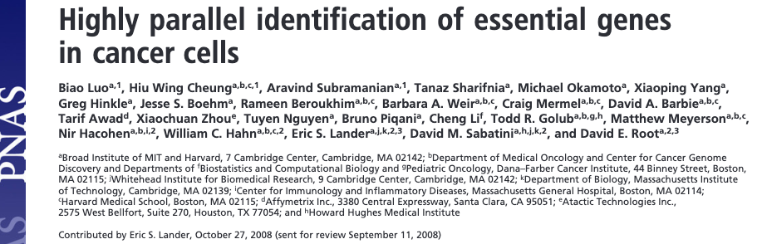
Future plan | Gene essentiality analysis
Hypothesis
➔ Genes from SAM pairs would be non-essential genes
➔ Essential genes : Genes that are critical for the survival organism, related with cell grown and proliferation etc
➔ Non-essential genes : Genes that are not critical for the survival organism as essential genes
➔ Essential genes in cancer cell : Essential for cancer cell proliferation (EGFR, KRAS and MYC etc)

Slide 28
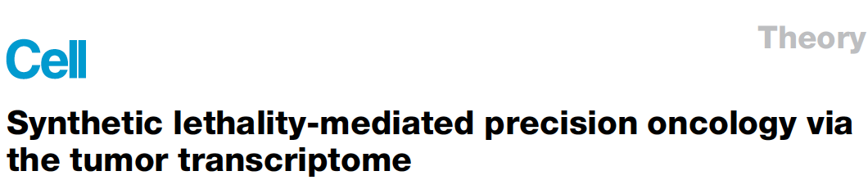
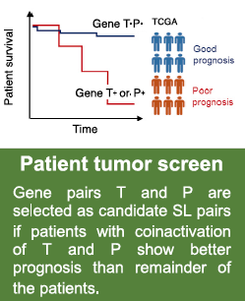
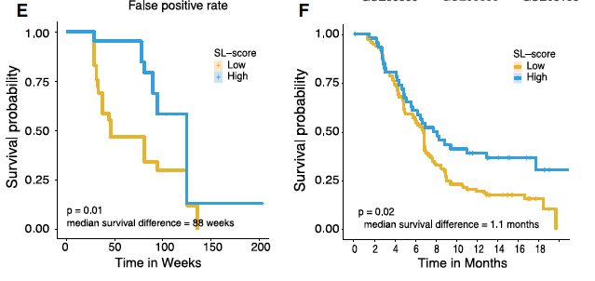
Future plan | Gene essentiality analysis
Hypothesis
➔ Genes from SAM pairs would be non-essential genes

Slide 29
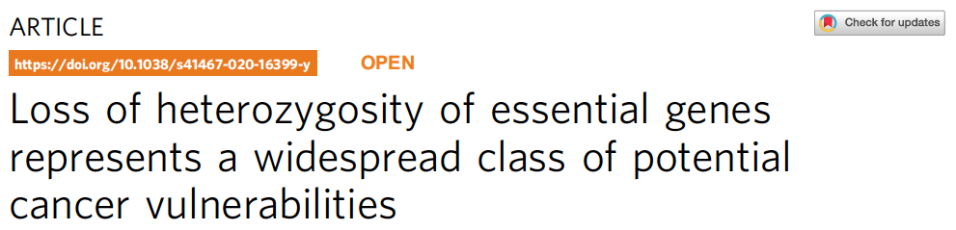
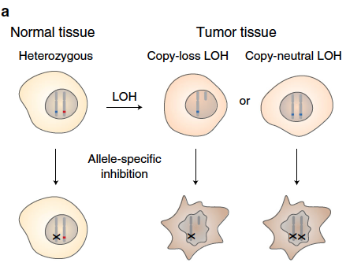
Future plan | Gene essentiality analysis
Hypothesis
➔ Genes from SAM pairs would be non-essential genes
1. Nominate candidate essential genes from genome-scale loss-of-function screens
2. Filter candidates based on gene copy-number and RNA expression data from CCLE
3. Filter based on CERES scores from CRISPR knockout screens from depmap
4. Rescue genes based on multiple screen evidence and CERES scores
5. Filter out known tumor suppressor genes
19,062 genes (1,482 essential genes, 17,580 non-essential genes)

Slide 30
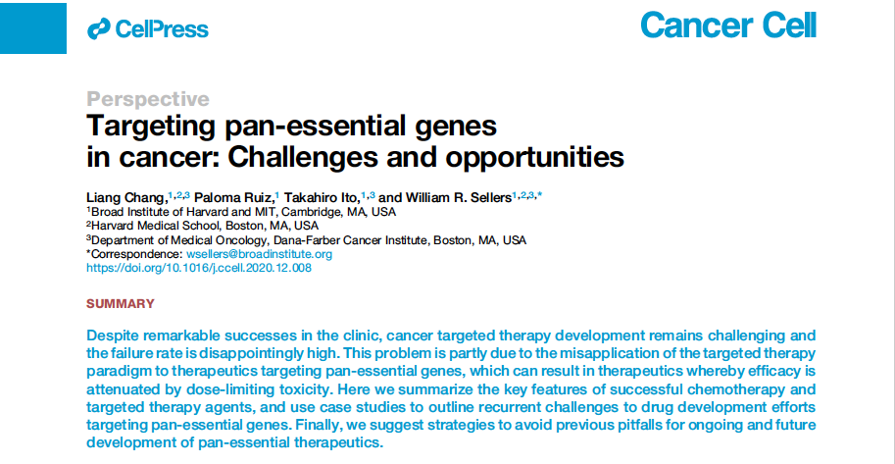
Future plan | Gene essentiality analysis
Hypothesis
➔ Genes from SAM pairs would be non-essential genes
1. Reference a study where genes whose depletion robustly impaired the viability of at least three out of five screened cell lines were included, yielding a list of 1,580 genes.
2. Recent advances in dual CRISPR screens using multiplexed sgRNAs, which revealed additional pan-essential paralogous gene pairs.
3. Compare a list of molecular targets of clinical-stage oncology drug candidates with a list of human pan-essential genes identified in at least two published CRISPR single-gene datasets.
Identified ~20 human pan-essential genes

Slide 31
Future plan | Gene essentiality analysis
Hypothesis
➔ Genes from SAM pairs would be non-essential genes
Pan-essential genes | Cell function | Representative drug and most recent progress
AURKA | cell-cycle regulation | alisertib (failed in a phase 3 trial in PTCL)
AURKB | cell-cycle regulation | barasertib (failed in a phase 2 trial in AML)
PLK1 | cell-cycle regulation | volasertib (failed in a phase 3 trial in AML)
CDC7 | cell-cycle regulation | TAK-931 (currently in a phase 2 trial in advanced solid tumors)
CDK4/6 | cell-cycle regulation | palbociclib (approved in combination with fulvestrant for treating HR + HER- breast cancer)
CDK1 | cell-cycle regulation | dinaciclib (failed in a phase 3 trial in CLL)
CDK9 | cell-cycle regulation | dinaciclib (failed in a phase 3 trial in CLL)
BRD4 | epigenetic regulation | CPI-0610 (currently in a phase 3 trial in myelofibrosis)
HDAC3 | epigenetic regulation | vorinostat (approved for CTCL, failed in 100 + clinical trials for various oncology indications)
DNMT1 | epigenetic regulation | azacitidine (approved for treating MDS)
PRMT5 | epigenetic regulation | GSK-3326595 (currently in phase 2 trials for various oncology indications)
SF3B1 | splicing regulation | H-3B8800 (currently in phase 2 trial in MDS)
NEDD8 | protein homeostasis | MLN4924 (currently in a phase 3 trial in AML and MDS)
20S proteasome subunits | protein homeostasis | bortezomib (approved for treating multiple myeloma and MCL)
ATM | DNA-damage response | AZD0156 (currently in a phase 1 clinical trial in solid tumors)
ATR | DNA-damage response | VX-970 (currently in phase 2 trials in multiple solid tumors)
WEE1 | DNA-damage response | AZD1775 (multiple phase 2 trials were terminated because of safety concerns)
CHK1 | DNA-damage response | MK8776 (failed in a phase 2 trial in AML)
KIF11 | microtubule stability | ARRY-520 (development halted after a phase 2 trial in multiple myeloma)
MEK1/2 | proliferation | trametinib (approved for treating BRAF-mutant advanced melanoma)
XPO1 | nuclear export | selinexor (approved for treating advanced diffuse large B cell lymphoma, and multiple myeloma)

Slide 32
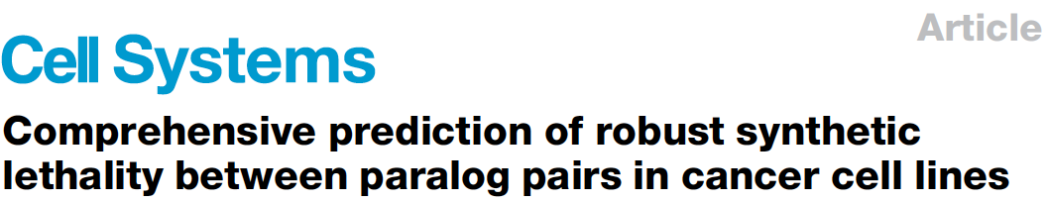
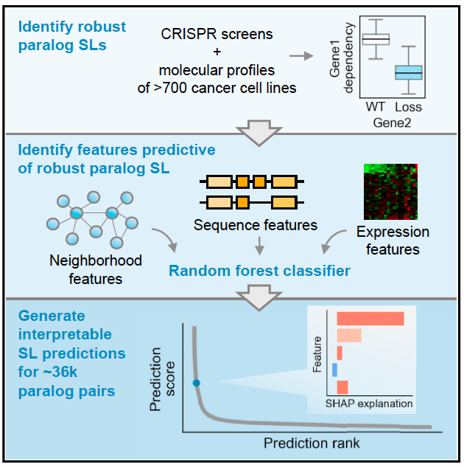
Future plan | Gene essentiality analysis
Hypothesis
➔ Genes from SAM pairs would interact with essential gene from PPI network
That paralog pairs that function in largely essential protein complexes (i.e., complexes with subunits that are frequently essential across the DepMap cell lines) or that have protein-protein interactions with essential genes are more likely to be SL.
➔ STRING (All or Physical links)
➔ BIOGRID

Slide 33
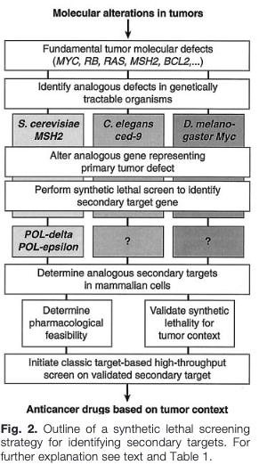
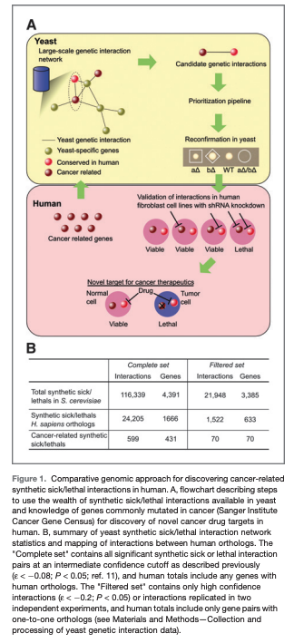
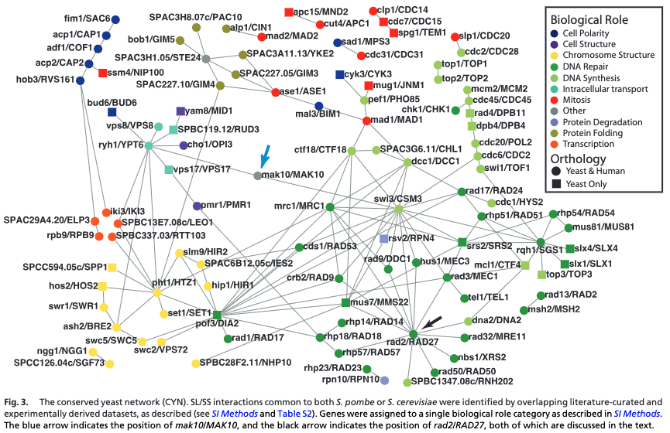
Future plan | Phylogenetic analysis
Hypothesis
➔ Two genes from SAM pairs would be phylogenetic similar each other.
➔ Based on observation that functionally interacting genes tend to co-evolve
➔ Calculate phylogenetic similarity to prioritize SL paired genes from several academic researches
➔ 19,017 genes and 86 species : 180,831,636 phylogenetic distances
- Lenand et al, Science, 1997
- Raamash et al, Cancer research, 2008
- Scott et al, PNAS, 2008

Slide 34
Thank you

Slide 35

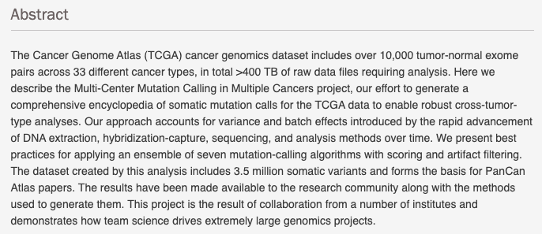
Data | TCGA MC3 Project information
MC3 Public MAF
mc3.v0.2.8.PUBLIC.maf.gz

Slide 36
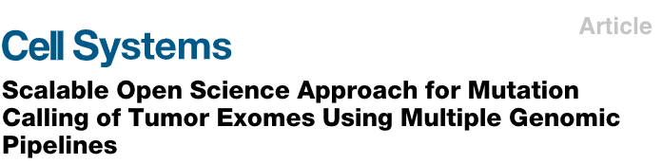
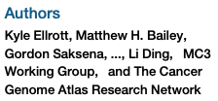
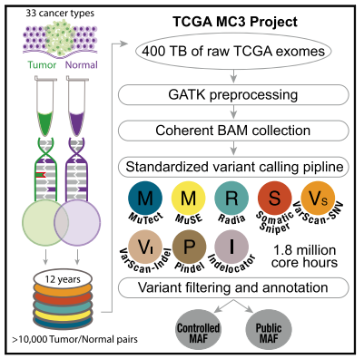
Data | TCGA MC3 Project information
MC3 Public MAF
mc3.v0.2.8.PUBLIC.maf.gz

Slide 37
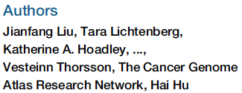
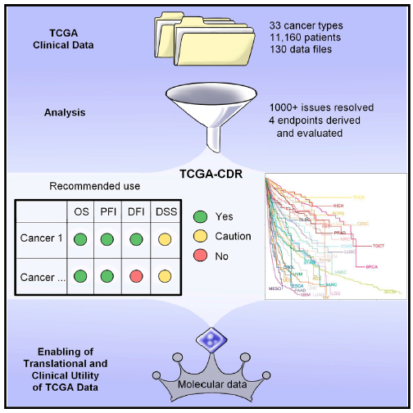
Data | TCGA Clinical Data Resource information
TCGA CDR Outcome
11,160 patients with 33 cancer types

Slide 38
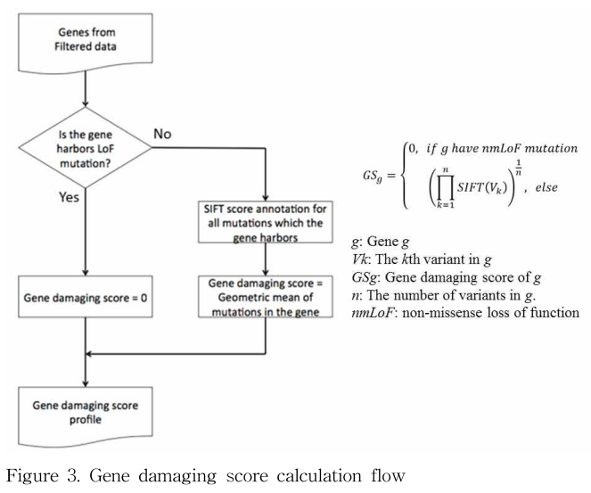
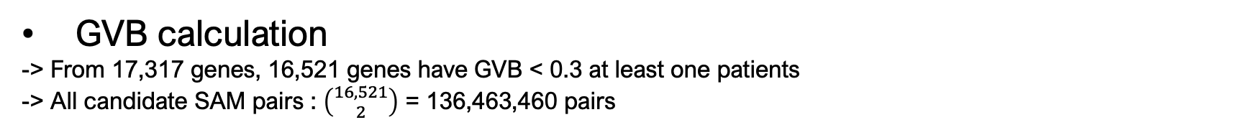
Method | Calculate Gene-wise variant burden(GVB) score
GVB calculation
-> From 17,317 genes, 16,521 genes have GVB < 0.3 at least one patients
-> All candidate SAM pairs : $\left({16,521 \atop 2}\right)$ = 136,463,460 pairs

Slide 39
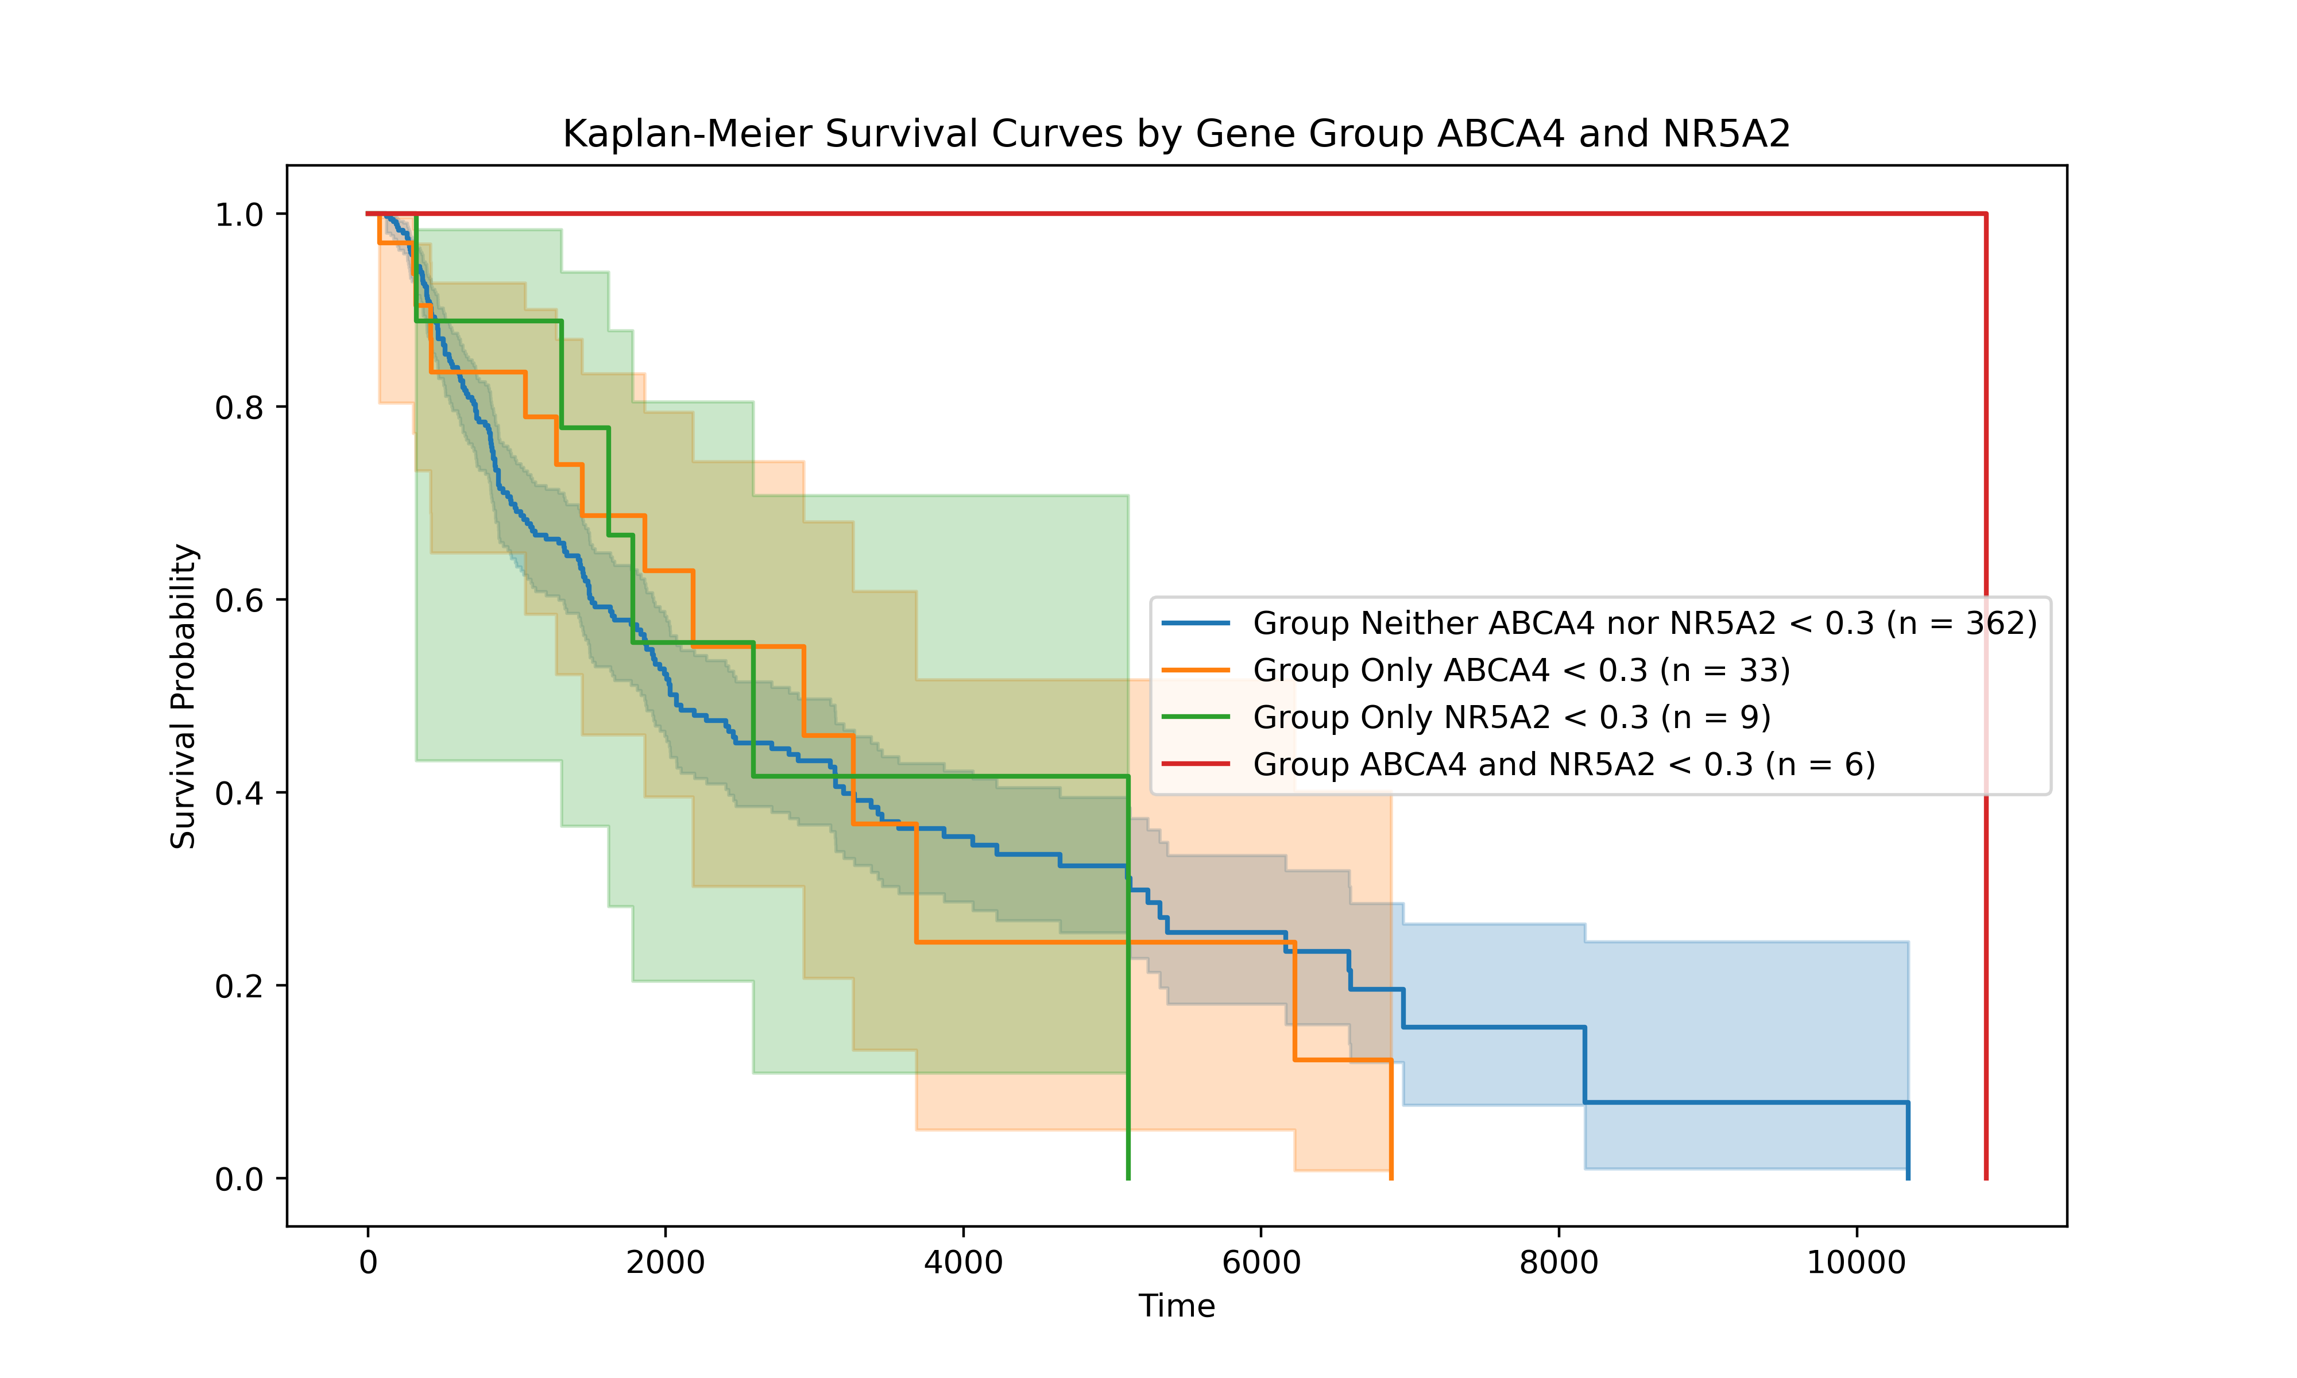
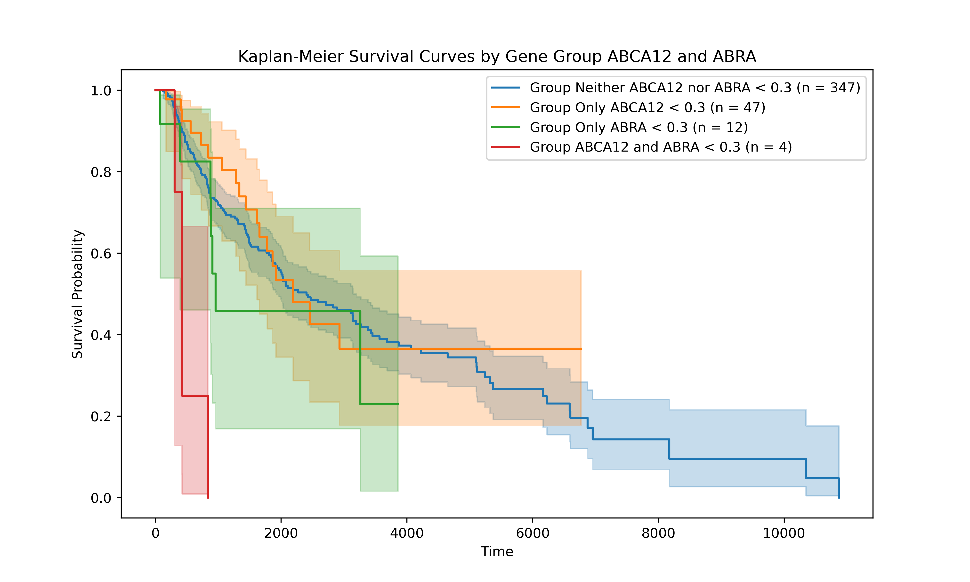
Result | SAM pairs from SKCM
Cox regression p-value < 0.05
-> Hazard ratio < 1 : 123 pairs, 146 genes
-> Hazard ratio > 1 : 3,835 pairs, 1,265 genes
ABCA4, NR5A2
HR : 0.4155, P-value : 0.0445
ABCA12, ABRA
HR : 2.8418, P-value : 0.0043

Slide 40
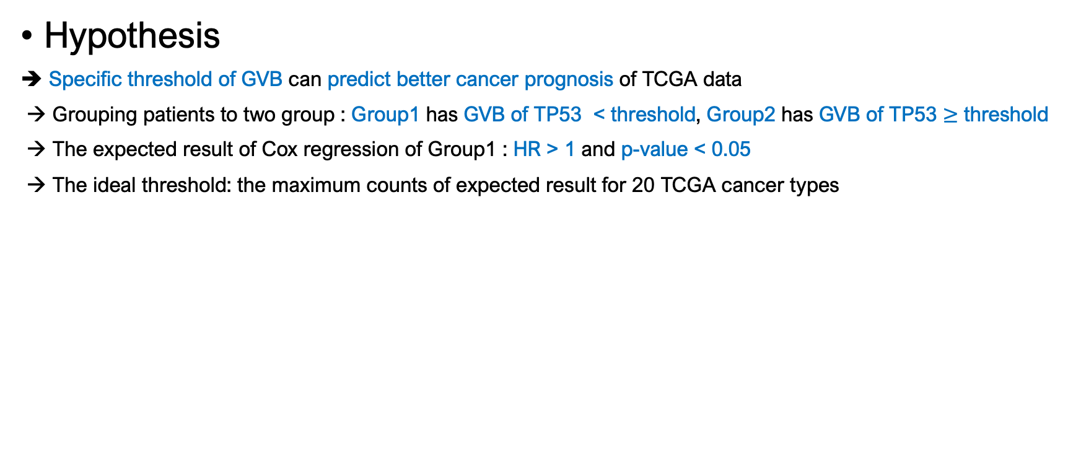
Future plan | Define ideal threshold of GVB
Hypothesis
➔ Specific threshold of GVB can predict better cancer prognosis of TCGA data
→ Grouping patients to two group : Group1 has GVB of TP53 < threshold, Group2 has GVB of TP53 $≥$ threshold
→ The expected result of Cox regression of Group1 : HR > 1 and p-value < 0.05
→ The ideal threshold: the maximum counts of expected result for 20 TCGA cancer types

